Slide 1

Using GPT API Models as Second Screener of Titles and Abstracts in High-Quality Systematic Reviews
Mikkel Helding Vembye, PhD
SRMA SIG, 15.11.2024

Slide 2
Common issue in large-scale reviews
Independent human double-screening of titles and abstracts is time-consuming and a resource-dependent procedure which
slows the review-process
(most often) forces reviewers to make too narrow search strings
is costly in terms of skilled human labor
makes some topics non-reviewable due to the number of references to screen for relevance
Overlooking relevant studies at the initial review stage can be consequential, leading to substantially biased results
This issue will only grow in size in future reviews as the databases grow bigger every year
To alleviate this issue we suggest substituting the human second screener with a GPT (Generative Pre-trained Transformer) API (Application Programming Interface) model.

Slide 3
What do I mean by screening with a GPT model?
Let me demonstrate to give you a practical understand of this screening approach.

Slide 4
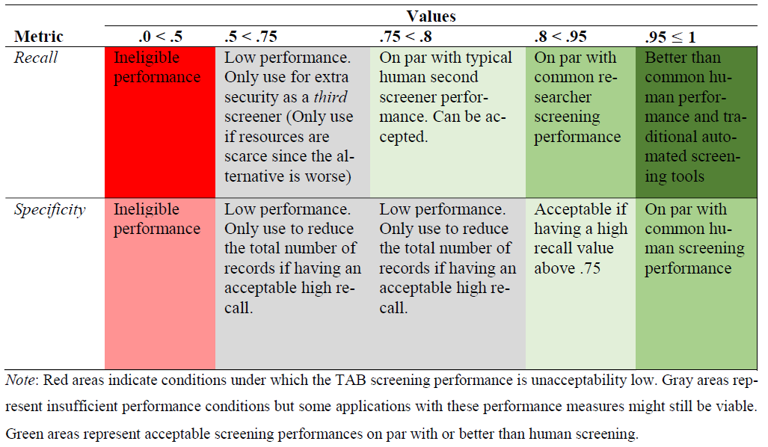
The benchmark scheme
In light of the typically human screening performances, we developed the following benchmark scheme. The aim is to help assessing screening performances of in general but also to judge when GPT screening is appropriate in high-standard reviews.

Slide 5
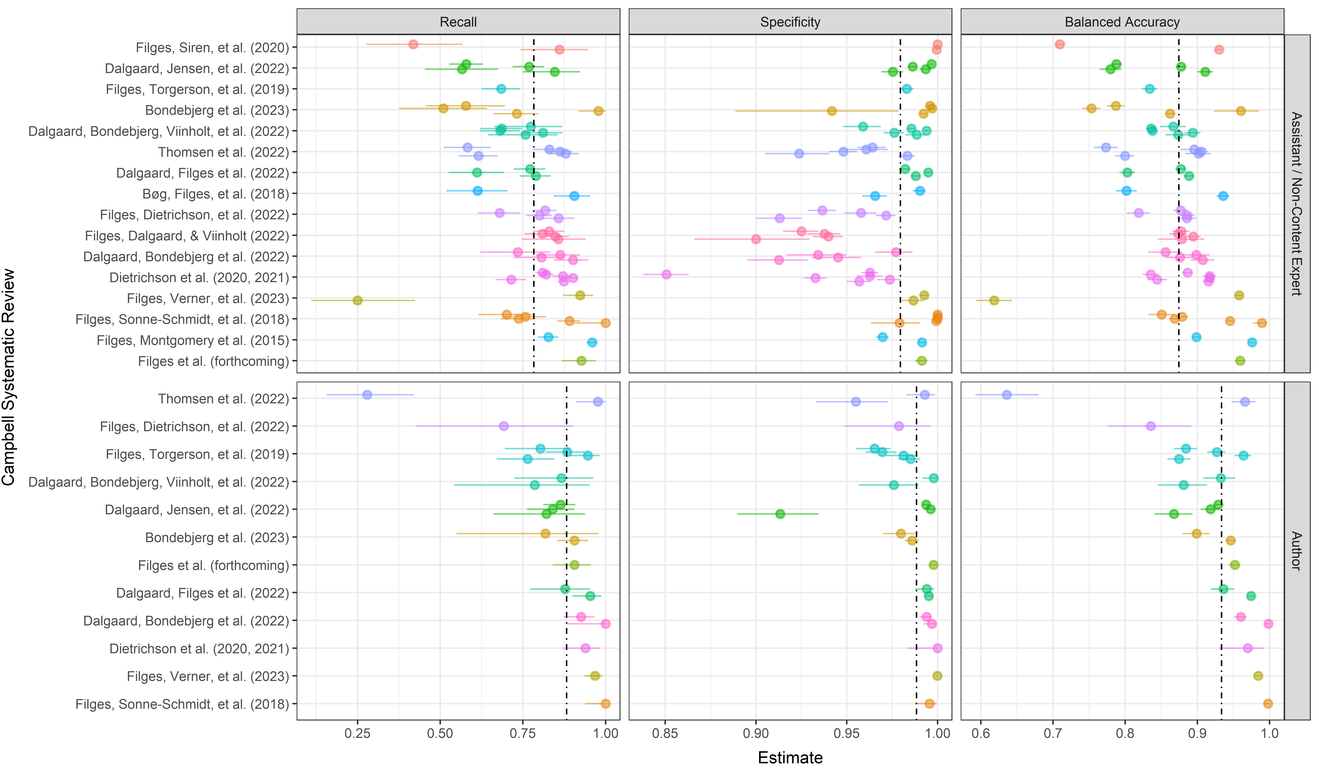
Typical human screening performance
To make fair comparisons between GPT and human screening, we mapped common human screening performances across 22 high-quality reviews. Hereto, we found the typical second screener to have a recall of 78.2%, 95% CI[74.7, 81.7] and specificity of 98%, 95% CI[96.6, 99.0].
Note: Dashed lines indicate the average estimated via the CHE-RVE model. Each point represent an individual screener within the given review
Notes:
Add what statistical approach we used.

Slide 6

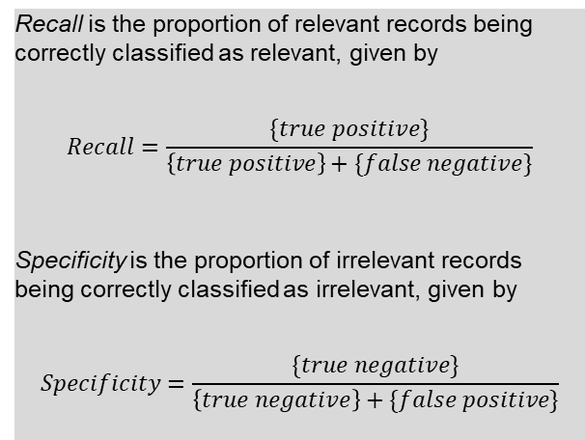
How generalizable is this approach?
We find that GPT API models can perform on par with or in some cases even better typical human second screeners in high-quality systematic reviews (Vembye et al., 2024).
We conducted three large-scale classification experiments with different levels of complexity in terms of the number of inclusion criteria.
In simple screening cases, we even find recall close to 100% and with a high specificity values (97.4%), as well.
In complex review settings, we find the GPT-4 model to yield a recall of 80%.
Yet, in complex review setting, the GPT-4 model is rather over-inclusive with a specificity of ~84%.
However, we argue this is not as problem as long as the recall is high (i.e., on par with humans) since a low specificity does not induce any bias to a review.
Recall is the proportion of relevant records being correctly classified as relevant, given by
$$Recall=\frac{\{true positive\}}{\left\{true positive\right\}+\{false negative\}}$$
Specificity is the proportion of irrelevant records being correctly classified as irrelevant, given by
$$Specificity=\frac{\{true negative\}}{\left\{true negative\right\}+\{false positive\}}$$
Notes:
Add gpt-4o-mini results

Slide 7

What we also do: standardization
To standardize this screening approach, we further developed
Common guidelines for when it is (and when it is not) appropriate to use GPT API models for title and abstract screening in high-quality reviews. These guidelines are primarily based on the benchmark scheme.
A workflow for how to configure a reliable screening, including how to test and develop prompts. Hereto we introduce multiple-prompt screening, i.e., making one prompt per inclusion criteria.
The AIscreenR R package (Vembye, 2024). This (among other things) allows the user to screen with multiple prompts and with parallel processing. To exemplify, we have been able to screen 14.000 references with 1 prompt and the gpt-4o-mini in less than 30 minutes (prize, $1.45 USD). The package also includes a practical/user-friendly step-by-step tutorial.

Slide 8
Advantages of this screening method
Rigorous treatment of all titles and abstracts
It is fast
It is cheap
You can guard against human drifting.
Extra ensurance that you have found all revelavant records.
Agnostic to data imbalance [i.e., INSERT]

Slide 9
Limitation
In theory it is prompt sensitive
Off-the-shelf method. We got desk rejected in RSM for this reason.
Environmental impact. This hard to fully assess but many people have concerns about this.

Slide 10
Concerns for future research
Some highlights for future research:
Investigate how our result generalize to other (and cheaper) models, such as the GPT-4o and GPT-4-turbo models as well as models from other companies such as Claude 2 and Mistral AL.
Test it with local models. This would freeze the efficacy of this approach and increase transparency of this approach. Our paper was desk rejected by RSM because we draw on an off-the-shelf model that can change over time.
Consider how best to combine traditional automated screening tools with GPT API screening. For instance can GPT API models play a role in validating stopping rules when using priority screening algorithms?

Slide 11
References:
Vembye, M. H. (2024). AIscreenR: AI screening tools for systematic reviews. (GitHub version 0.0.0.9999). https://mikkelvembye.github.io/AIscreenR/
Vembye, M. H.; Christensen, J.; Mølgaard, A. B.; Schytt, F. L. W. (2024). GPT API models can function as highly reliable second screeners of titles and abstracts in systematic reviews: A proof of concept and common guidelines. Open Science Framework (OSF). https://doi.org/10.31219/osf.io/yrhzm

Slide 12
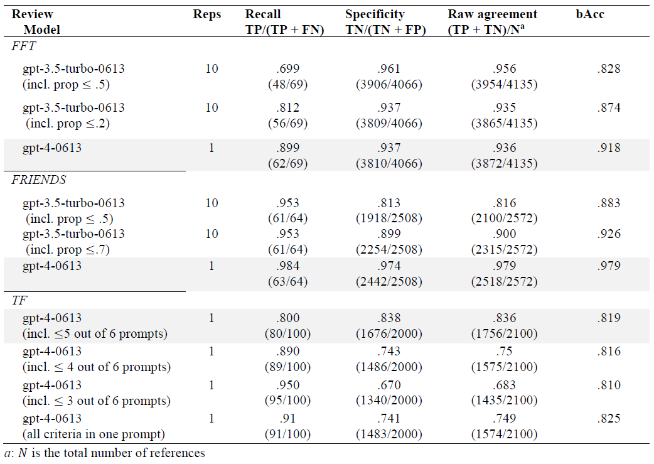
Appendix – all results

